Slide 1
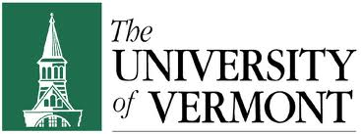
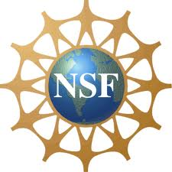
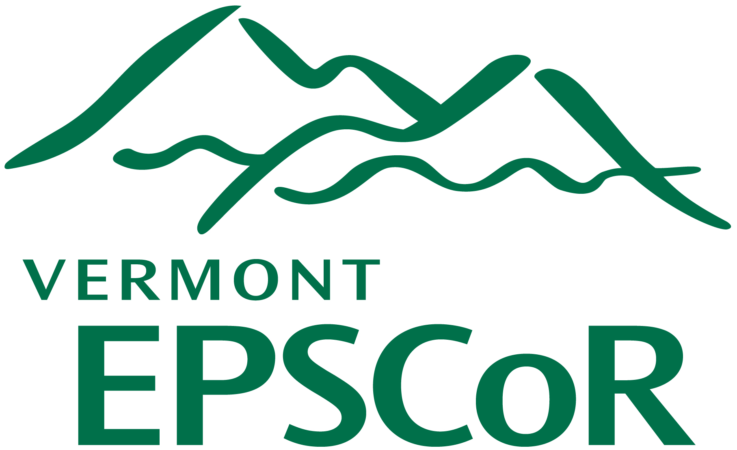
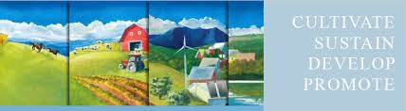

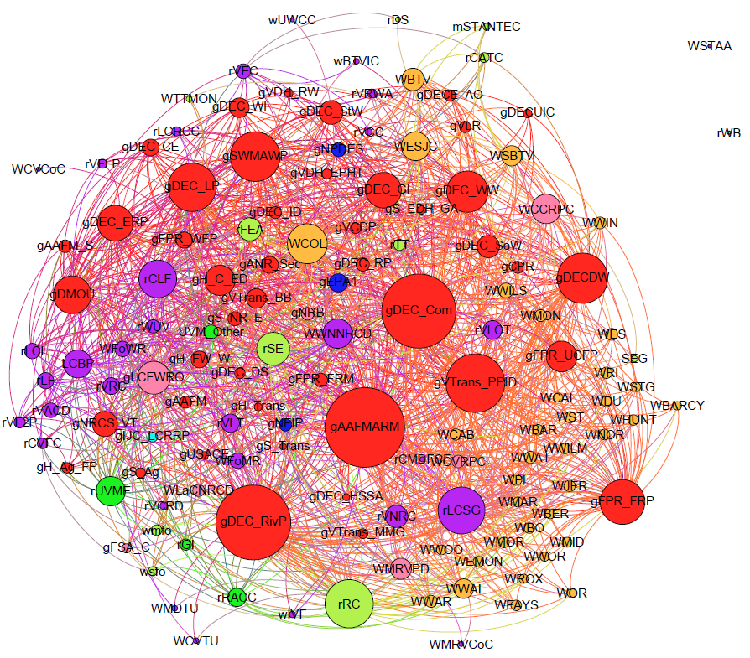
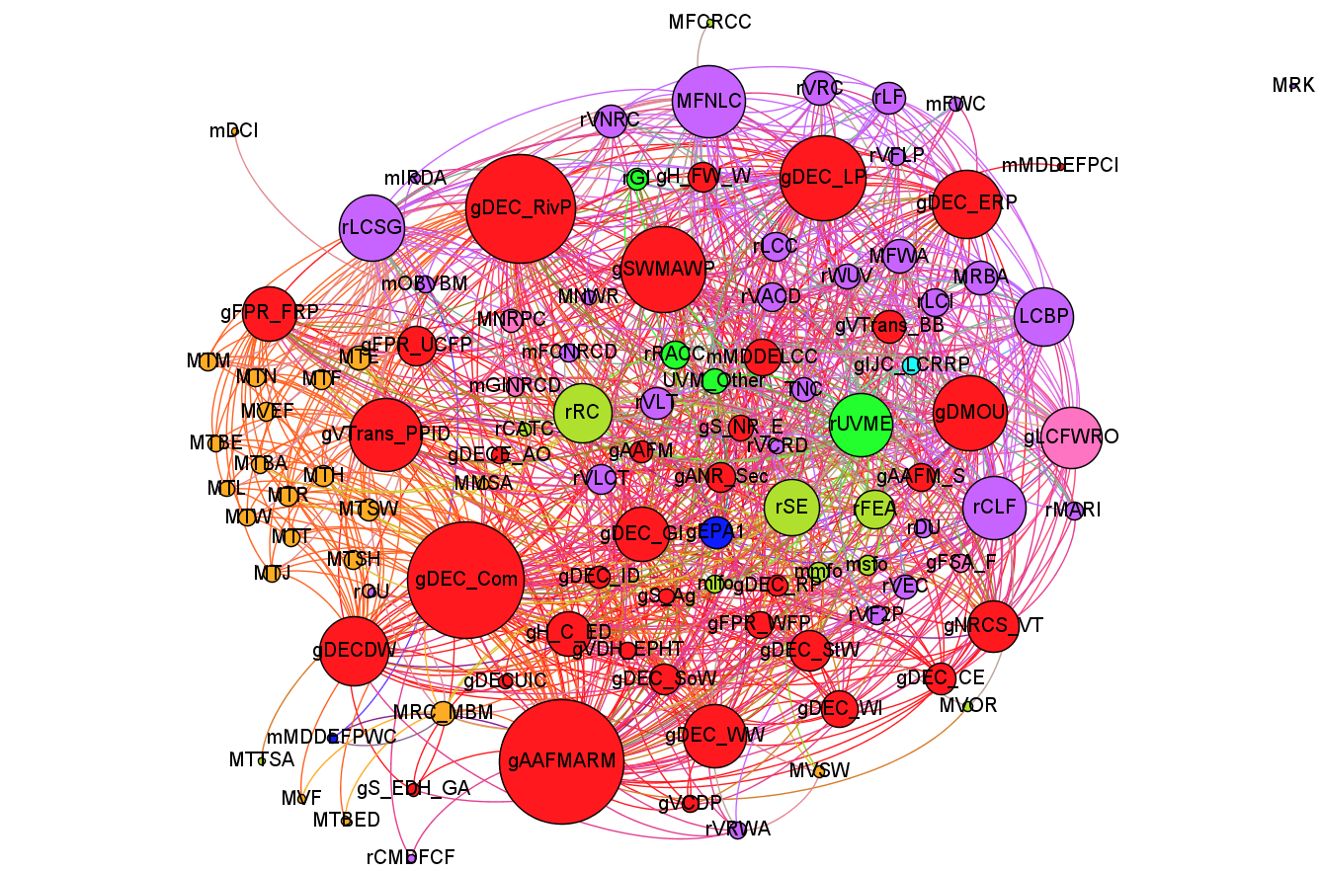
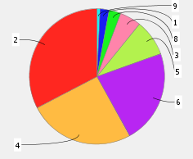
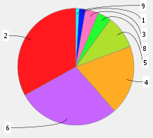
Agriculture Technical Assistance Provider Networks for the Missisquoi and Winooski Watersheds
Steve Scheinert, Christopher Koliba, Asim Zia, Stephanie Hurley
University of Vermont; Vermont EPSCoR
UVM College of Agriculture & Life Sciences
UVM Extension
BASIC RESEARCH QUESTIONS: How are agricultural technical assistance (TA) providers coordinated in the two selected watersheds? How does the sectoral composition of the two networks differ? Which organizations are the most connected to other organizations in the network (i.e., have highest degree centrality)?
METHODS EMPLOYED: Institutional network analysis was conducted in *ORA using data drawn from a comprehensive survey of watershed management organizations and programs operating within the Lake Champlain Basin. Network figures are made in Gephi.
RESULTS/CONCULSTIONS: (1) Governing actors of all types constitute around 75% of the actors in each network. (2) Key TA providers UVM Extension and NRCS are not among the most central in either network. (3) NGOs are more central in the Missisquoi than in the Winooski TA provider network. (4) Incentive and subsidy providing state programs are the most central organizations in both networks.
Figure 1: Winooski Watershed Agricultural TA Provider Network Figure 2: Missisquoi Watershed Agricultural TA Provider Network
Figure 3. Sectoral Composition of Ag. TA Provider Nets
Table 1: Winooski Top 10 Nodes by Degree Centrality
Sector Label Key:
1.Federal Governing Actors
2. State/Provincial Governing Actors
3. Regional/Geo-governing Actors
4. Local/Municipal Governing Actors
5. Private (For-Profit) Enterprise
6. Non-Governmental and Non-Profit Org.
7. Citizen Actors
8. Research Actors
9. International Governing Actors
Table 2: Missisquoi Top 10 Nodes by Degree Centrality
Winooski Watershed
Missisquoi Watershed
This document was developed by support provided by Vermont EPSCoR with funds from the National Science Foundation Grant EPS-1101317. Any opinions, findings, and conclusions or recommendations expressed in this material are those of the author(s) and do not necessarily reflect the views of the National Science Foundation, VT EPSCoR, or the University of Vermont.

